Slide 1


Correlation of Discrete-Time Signals
Transmitted Signal, x(n)
Reflected Signal,
y(n) = x(n-D) + w(n)
0
T
Dr. B.S. Daga , FRCRCE,MUMBAI

Slide 2
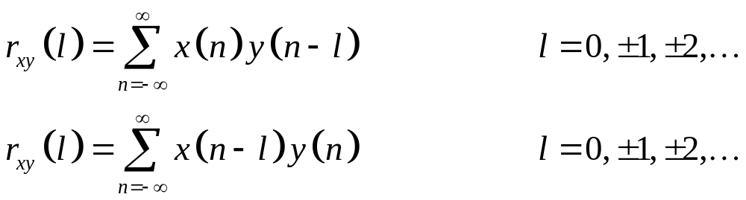
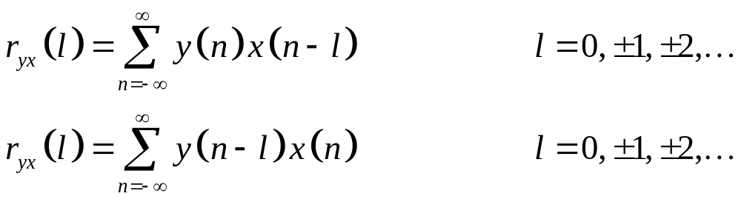
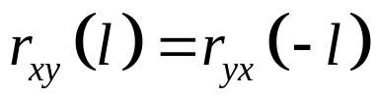
Cross-Correlation
Cross-correlation of x(n) and y(n) is a sequence, r_{xy}(l)
Reversing the order, r_{yx}(l)
=>
Dr. B.S. Daga , FRCRCE,MUMBAI

Slide 3
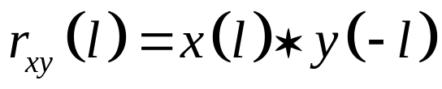
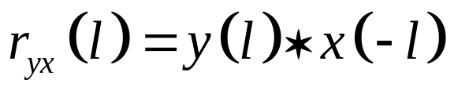
Similarity to Convolution
No folding (time-reversal)
In Matlab:
  Conv(x,fliplr(y))
Dr. B.S. Daga , FRCRCE,MUMBAI

Slide 4
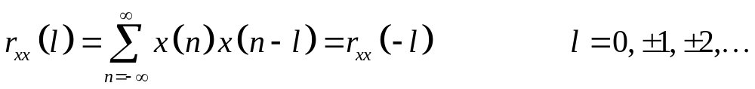
Auto-Correlation
Correlation of a signal with itself
Used to differentiate the presence of a like-signal, e.g., zero or one
Even function
Dr. B.S. Daga , FRCRCE,MUMBAI

Slide 5
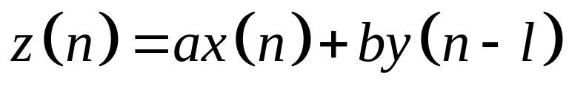
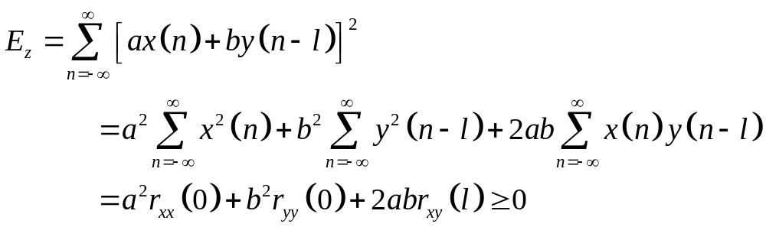
Properties
Two sequences, x(n) and y(n), with finite energy
Find energy of z(n)
E_{x}
E_{y}
Dr. B.S. Daga , FRCRCE,MUMBAI

Slide 6
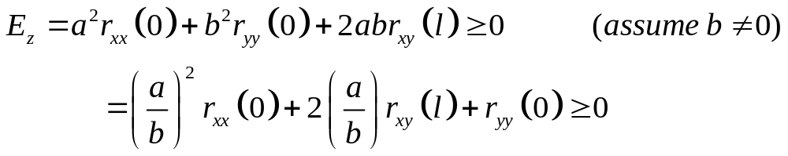


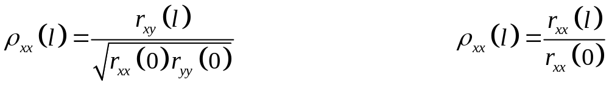
Quadratric in (a/b) and positive, discriminant is non-negative:
For crosscorrelation case:
For autocorrelation case:
Maximum value occurs with zero lag (when signals are perfectly matched)
Often normalized to range [-1,1]:
Dr. B.S. Daga , FRCRCE,MUMBAI

Slide 7
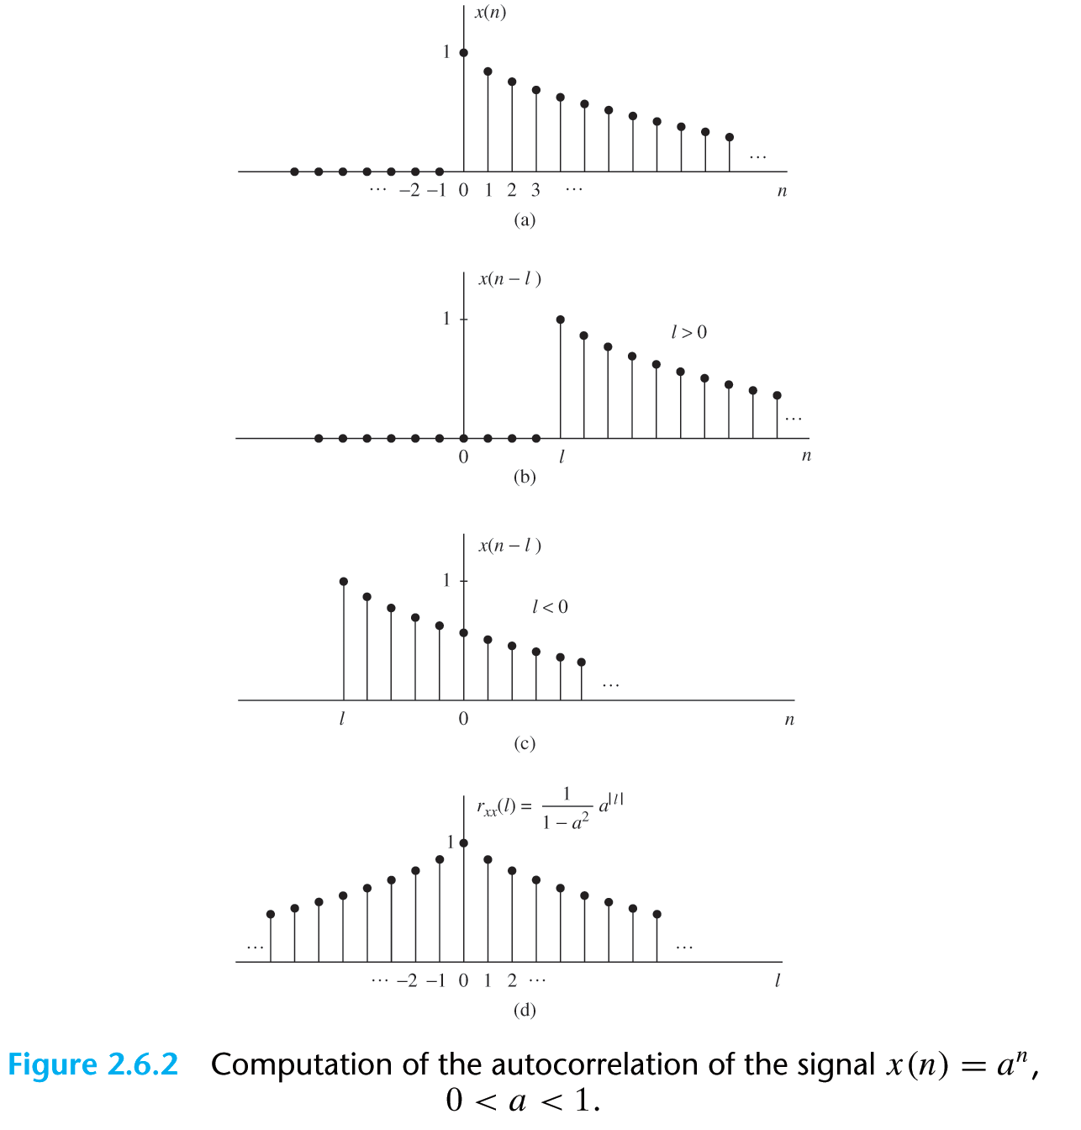

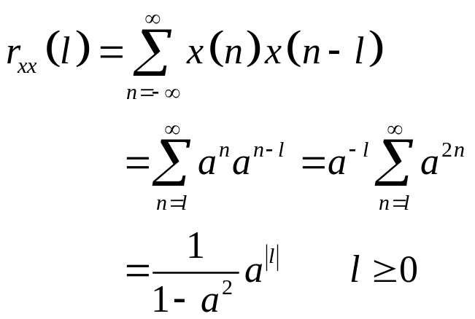
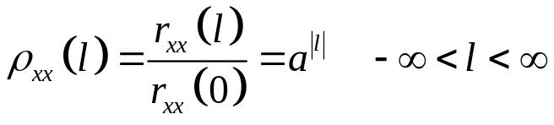
Dr. B.S. Daga , FRCRCE,MUMBAI

Slide 8
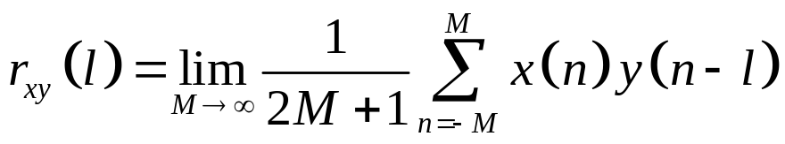
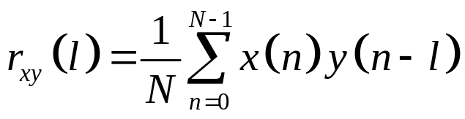
Periodic Sequences
Power signals crosscorrelation:
Define auto and crosscorrelations over one period of the signals
If x(n) and y(n) are periodic signals with period N:
Correlations are also periodic with period N
Dr. B.S. Daga , FRCRCE,MUMBAI

Slide 9
Dr. B.S. Daga , FRCRCE,MUMBAI

Slide 10
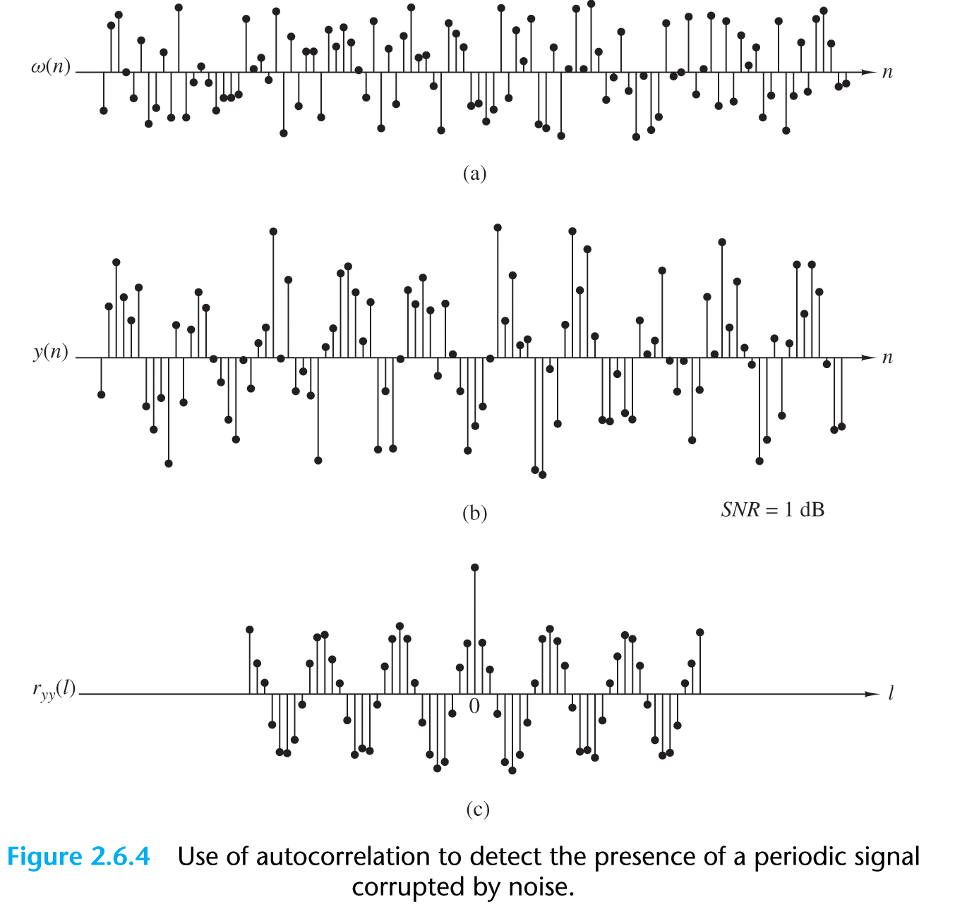
y(n)=x(n)+w(n)
Dr. B.S. Daga , FRCRCE,MUMBAI

Slide 11
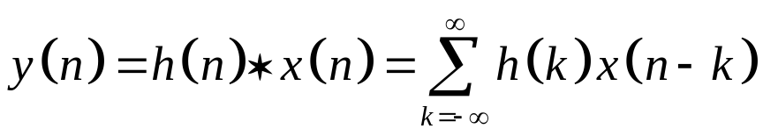
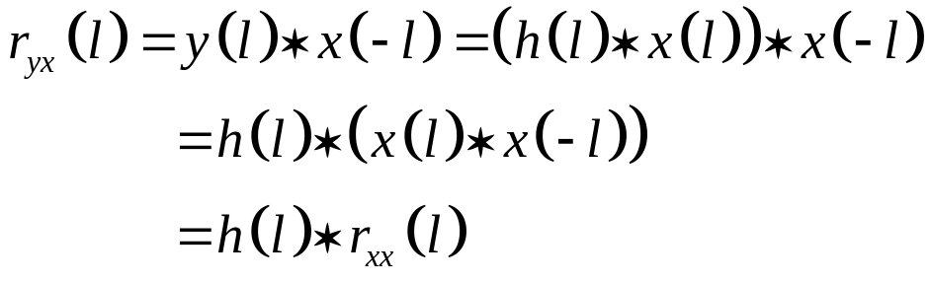

LTI Systems
Convolution, output of LTI system
Crosscorrelation between the output and input signal:
Similarly, input to output is:
Dr. B.S. Daga , FRCRCE,MUMBAI

Slide 12
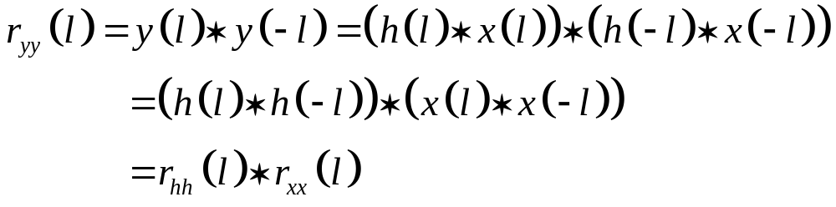
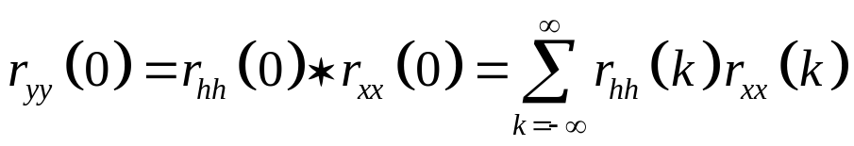
Autocorrelation of output:
Dr. B.S. Daga , FRCRCE,MUMBAI

